Slide 1

Fake News Detection
Identifying fake news has become an important issue. Increasing usage of social media has led to an increase in the number of people who can be influenced, thus the spread of fake news can potentially impact important events. Fake news has become a major societal issue and a technical challenge for social media companies to identify and has led many to extreme measures, such as WhatsApp deleting two million of its users every month to prevent the spread of fake news. The current problem of fake news is rooted in the historical problem of disinformation, which is false information intentionally, and usually clandestinely, disseminated to manipulate public opinion or obfuscate the truth. My work addresses the problem of identifying fake news by detecting and analyzing fake news features, identifying the textual and sociocultural characteristics of fake news features.
The problem is real and hard to solve because the bots are getting better and are tricking us. Is not simple to detect when the information is true or not all the time, so we need better systems that help us understand the patterns of fake news to improve our social media, communication and to prevent confusion in the world.

Slide 2
The aim of this project is to walk through the process of creating a machine learning model using python and NLP in order to successfully detect fake news.
This project aims to apply different algorithms & techniques on Credit Card Fraud data set and compare the results.
Measures used to compare those are Precision and Recall.
To get high accuracy to determine a news is fake or true.
MAIN GOAL

Slide 3
The Data
The data comes from Kaggle, you can download it here:
https://www.kaggle.com/clmentbisaillon/fake-and-real-news-dataset
There are two files, one for real news and one for fake news (both in English) with a total of 23481 “fake” tweets and 21417 “real” articles.

Slide 4
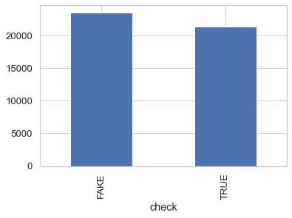
In the class distribution we want to know:
How many news are fake and how many are true?
We have 23481 fake news and 21417 true news.
We have a balanced mix of true and fake articles.
Methodology
The approach proposed for this project is:
Data Preprocessing
Generating News Feature Vector
Classification

Slide 5
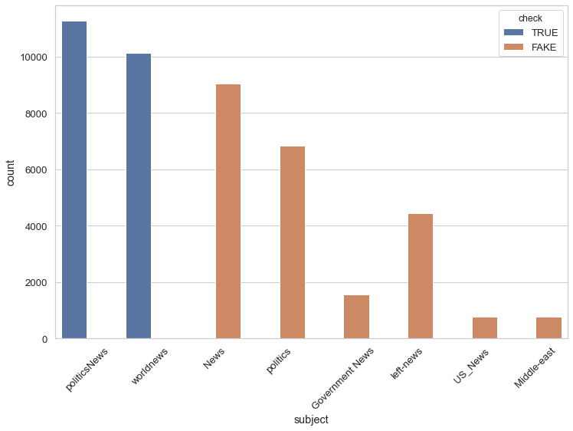
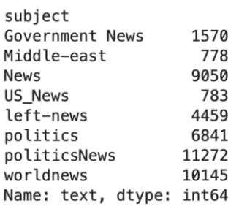
We have politics News, world news as True and the rest of the news which include News, politics, Government News, left-NewNews,US_News,
Middle-east are Fake.

Slide 6
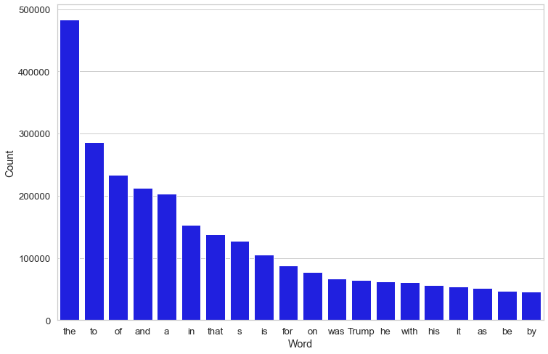
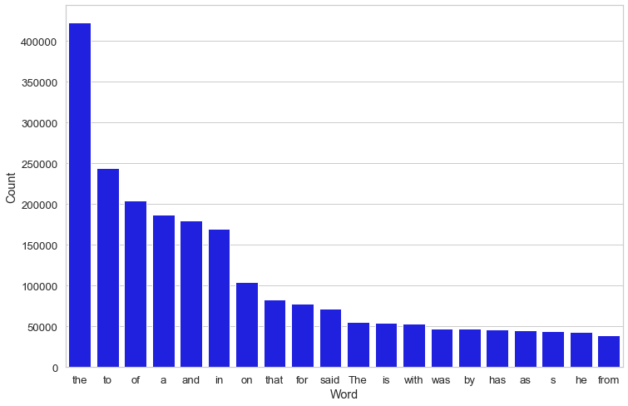
We can see most frequent words in real and fake news in plot:
Fake news:
True news:

Slide 7
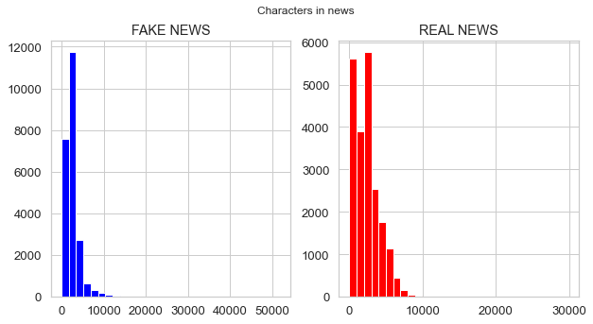
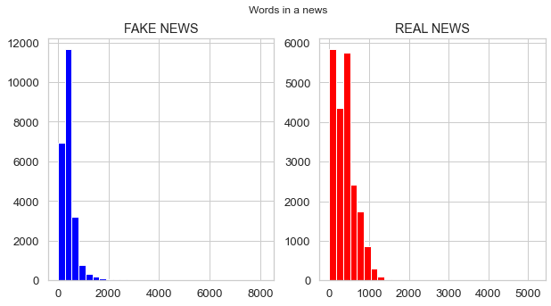
Number of characters in news
As we can see from analysis number
of characters in Fake news is more than
of Real news, because fake news generally
use more characters to grab the attention.
Number of words in news
As we can see average number of words in real headlines is relatively less in comparison to fake news.

Slide 8
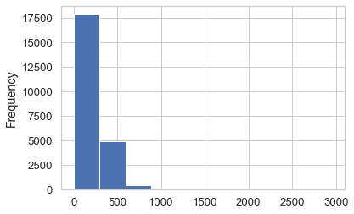
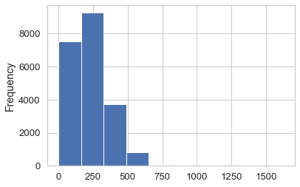
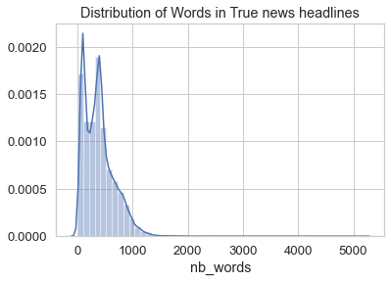
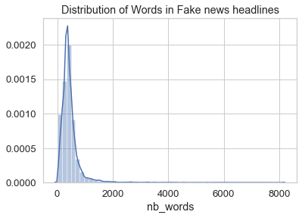
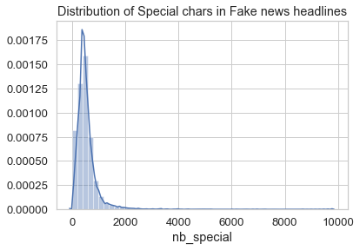
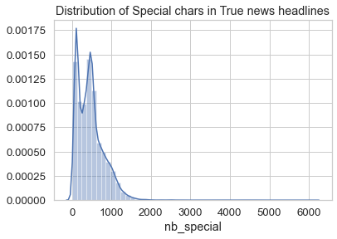
As we can see in these plots:
1. There are some more special
Character in fake news than real
News less use of special characters.
2. There are some more words
In a fake news(right-skewed) than
Real news, because fake news use superfluous language with more
Words to grab the attention.

Slide 9

Detecting Fake News With Natural Language
Processing ( NLP ):
As human being, when we read a sentence or
A paragraph, we can interpret the words with
The whole documents and understand the context.
It is possible to teach to a computer how to read
And understand the difference between real news
And the fake news using Natural Language Processing
(NLP).

Slide 10
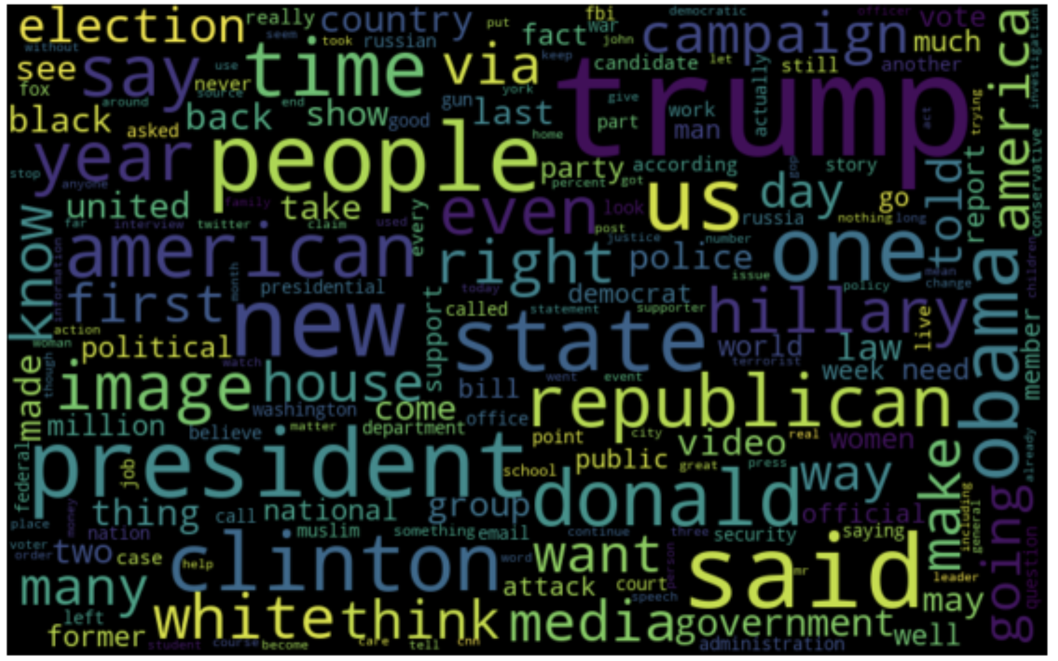
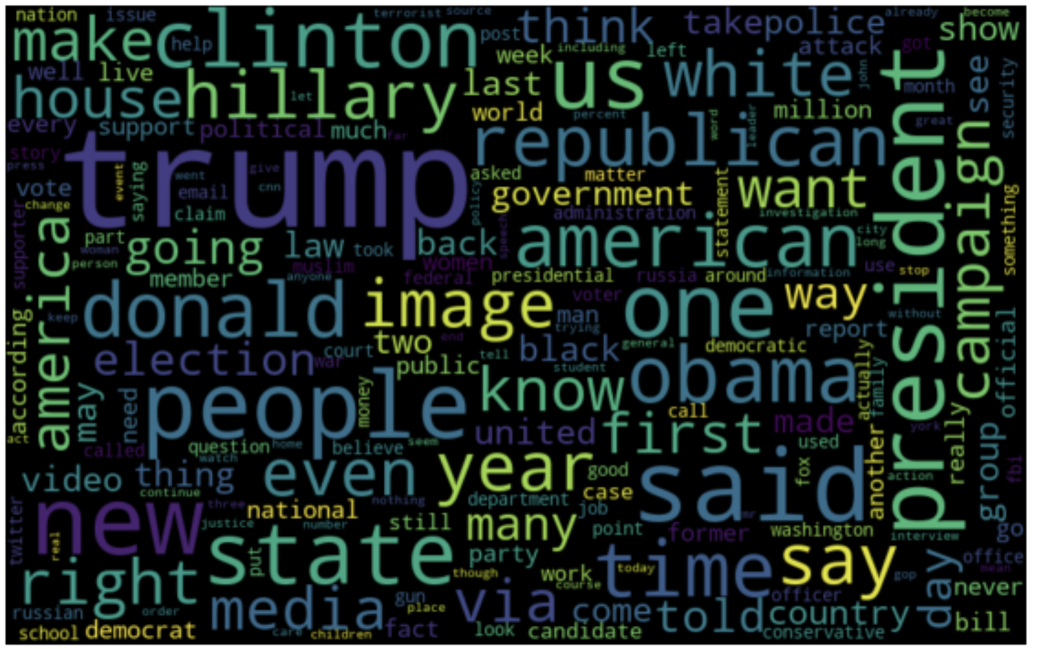
Word Cloud for fake news:
EDA
The purpose of EDA is to enhance our understanding of trends in the dataset without involving complicated machine learning models.
The last stage of my exploratory data analysis of the text is Word cloud analysis. Word cloud is a great way to represent text data. The size and color of each word that appears in the Word cloud indicate its frequency or importance.
In the results, we can see how often some words used in the news text in fake or real news.
Word Cloud for real news:

Slide 11

In text preprocessing we have to convert all the text to lower case.
Remove all the punctuations, stop words and digits.
We tokenize the sentences using the keras tokenizer.
After tokenizing we convert the sentences into sequence.
The padd the sequence
Preprocessing:

Slide 12
Tf-Idf Vectorizer is a common algorithm to transform text into meaningful representation of numbers. It is used to extract features from text strings based on occurrence.
In Preprocessing step we should convert the text to numbers which machine learning
Using simple model like bag-of-words to deal with text data. To get a good idea if the words and tokens in the articles had a significant impact on whether the news was fake or true, I can use CountVectorizer and TfidfVectorizer.
Term Frequency(Tf) — Inverse Document Frequency(Idf) Vectorizer and CountVectorizer:

Slide 13


Classification Models
The model used were Logistic Regression(LG), PassiveAgressive Clasiifier,
Naïve-Bayes(NB), Support Vector Machine(SVM), Random Forest(RF).
I will compare features and classifiers by their accuracy, Precision, Recall.

Slide 14
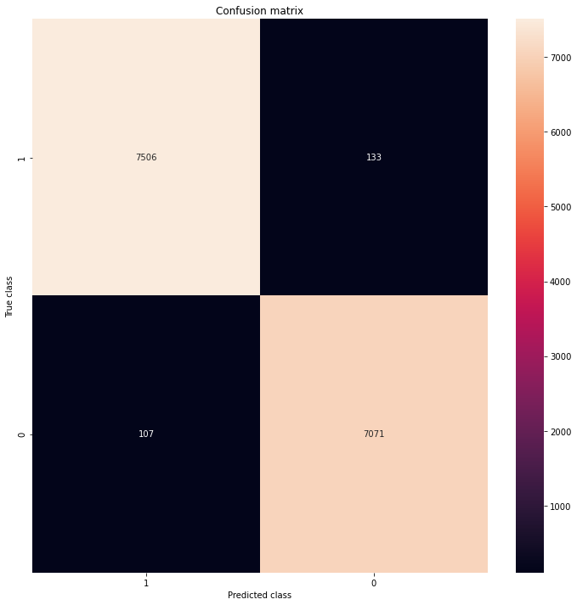

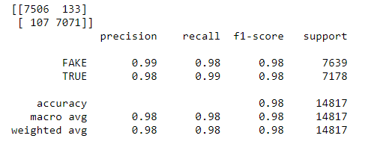
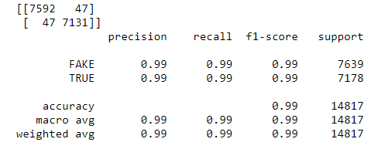
Logistic Regression
PassiveAggressiveClassifier

Slide 15
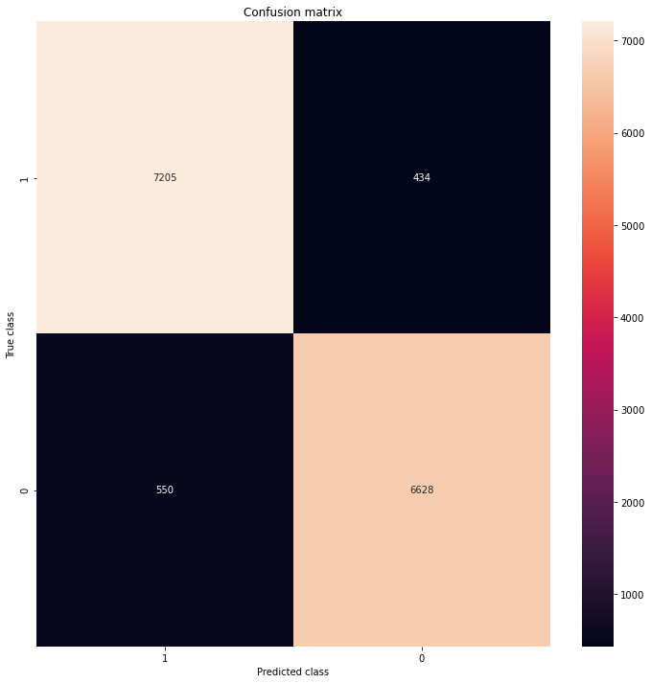
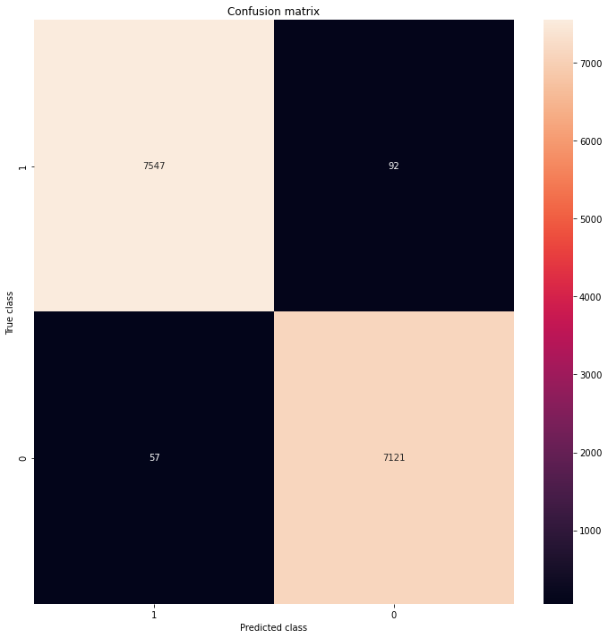
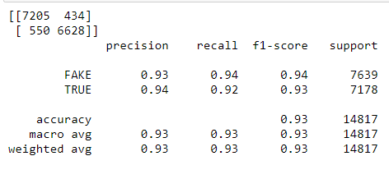
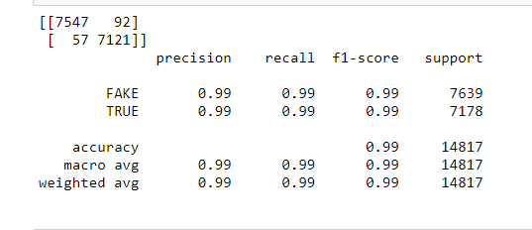
Naïve-Bayes
Support Vector Machine

Slide 16

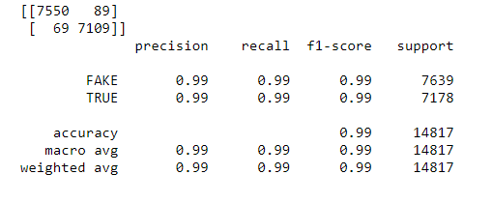
Random Forest

Slide 17

Model | Precision | Recall | Accuracy
Logistic Regression | 0.99 | 0.98 | 0.98
PassiveAgressive | 0.99 | 0.99 | 0.99
Naïve-Bayes | 0.93 | 0.94 | 0.93
Support Vector Machine | 0.99 | 0.99 | 0.99
Random Forest | 0.99 | 0.99 | 0.99
Model Performance

Slide 18
We successfully implemented a machine learning and
Natural Language Processing model to detect whether
An article was fake or real.
We got 7592 articles correctly identified as Fake and 7131
Correctly identified as real. When doing such a classification,
it is important to check that we limit the number of false positives
as they can cause real to be marked as fake.
I would like to choose PassiveAggressiveClassifier method, because this method has less false positive and false negative.
So overall PassiveAggressiveClassifier Method performed much better in determining in fake news cases which is around 99%
Conclusion

